Slide 1
Exploring the Domain of Choice DJS Program
Sam Mendimasa, Danila Frolov, Celestine Wong,
Cathy Poore, and Achuachua Tesoh-Snowsel

Slide 2
Agenda
Choice Program Info
DJS (Department of Juvenile Services)
Project Overview
Data Set
Questions
Goals
Demo (3)
How it was made
Results (3)

Slide 3
Introduction
UMBC Choice Program provides 50+ AmeriCorps members with opportunities to make a difference in the lives of youths living in Maryland’s highest risk communities.
The goal is to foster healthy development and resiliency among youth who face adverse individual or environmental challenges in their daily lives.
Choice DJS (Department of Juvenile Services)
Notes:
Mention that Choice has four initiatives.

Slide 4
DJS Choice Program
Aims to reduce recidivism and out-of-home placements, strengthen youth and family ties to the community through education and employment, and promote community safety.
DJS seeks to achieve their goals through the following:
face-to-face contact
increasing family engagement
supporting youth with probation/legal requirements

Slide 5
Project Description
Overview
Our client has Choice DJS data from July 2016 - June 2017
Two Data Sets:
Daily Logs: Reports of each visit/interaction conducted by AmeriCorps members
Calculations: Participant demographics, outcomes, various interactions
Client Questions:
How the young participants of the Choice Program are distributed within regions served by DJS?
What is the best time for DJS members to reach the youth by phone during a day?
How effective is the service of each of the DJS teams?
Notes:
The data for this project is a CSV file consisting of over a hundred thousand entries. This database was created and is being maintained by the 50 AmeriCorps members that volunteer for the Choice Program.
The file contains raw data collected during the period of July 2016 to July 2017 and includes information such as regions that participate in the program, teams that pursue the Choice Program mission, number of visits for each team, duration of each visit, youth demographics, dismissal reason, and contact methods (phone call, family visit, or face-to-face visit).

Slide 6
What we did?
We created three distinct visualizations ,where each visualization serve to answer one of the questions of our client
The visualizations are as follows:
Geographic Map
Heat Map
Parallel Sets

Slide 7
Dot Distribution Map (Demo)
What:
A geographical map created in Tableau showing how youth are distributed within different regions served by DJS members.
How:
Each youth was plotted on a map as a dot. Geographic data was plotted using custom longitude and latitude values derived from the addresses provided in the dataset using Java to parse and convert the data.
Why:
The map helps to see distribution and correlations as well as locate clusters and outliers.
Link

Slide 8
Phone Call Heat Map (Demo)
Day of the Week versus Time of Day
Log Data of all phone call attempts
Filter success phone calls
Categorize each date into day of the week
Categorize each time into hour of the day
Color Scale
Hovering over squares gives tool tip
Link
Notes:
Heat map for the aggregated sum of phone calls made for each day of the week at specific time of days.
Sunday, Monday, Tuesday versus 1am, 2am to 11:
Example:
Color Scale:
Blue is a neutral color, and as it progresses, the color gets darker to show more calls
Some day-times have 0 calls, and at most 199 calls from the whole year
Tool tip gives the specific number as to how many calls were made

Slide 9
Team’s Effectiveness Parallel Set (Demo)
Parallel sets to explore trends in the data that correlates to Team’s effectiveness
Parallel sets requires categorical data and having too many categories leads to an unreadable visualization so for some categories, we condensed similar data such as number of visits or outcomes into fewer possible values.
Our visualizations allows for further exploration of the data by offering the ability to further explore subsets of the data and add or remove categories as needed.
Created with Java, OpenGL, Sqlite
Notes:
Data was filtered into categories
Eight teams
Four outcomes - ongoing, successful, unsuccessful, other
Number of home visits - 1-74, 75-149, 150+
Additional categories in drill down - gender, race

Slide 10
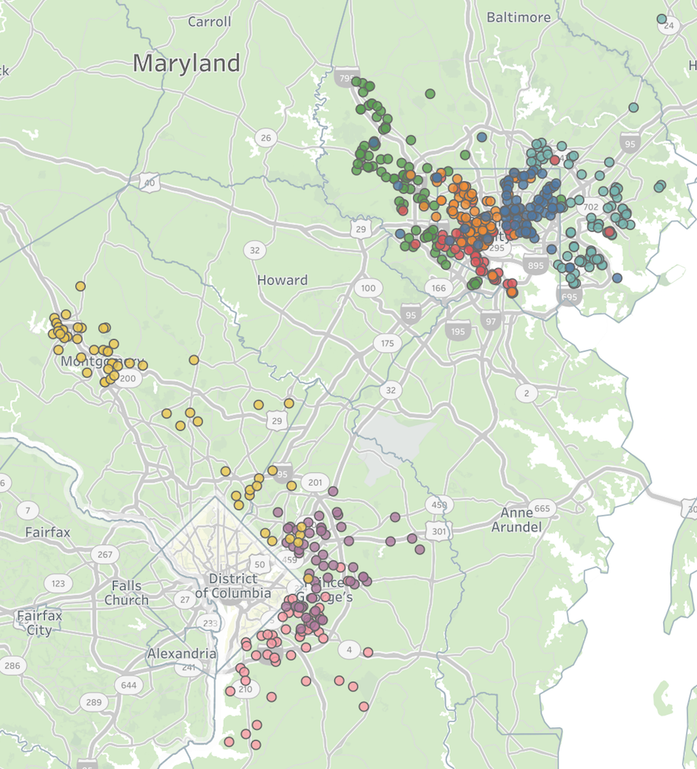
Results
Location Distribution Map
Visualization Findings: Most youth are located in Baltimore City and there are outliers for almost all teams.
Client Response: Met our client’s goal of easily identifying the distribution of the teams and the youths they served.

Slide 11
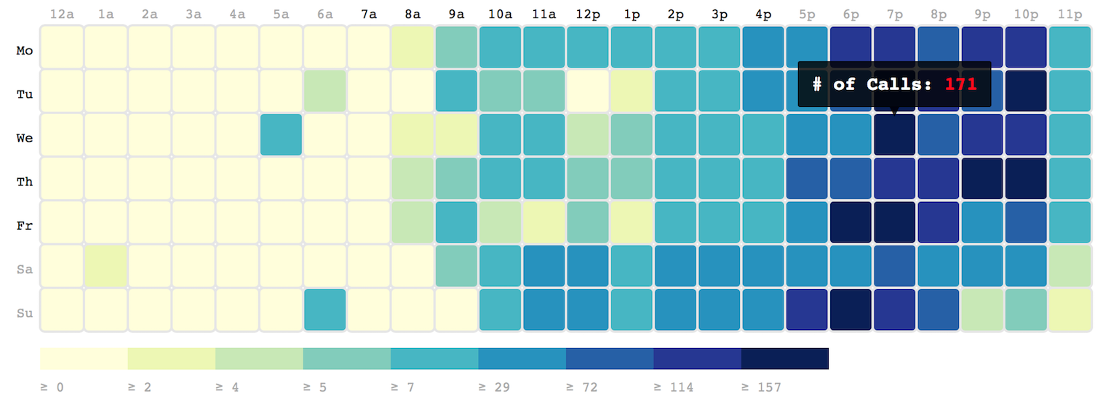
Results
Phone call Heat Map
Visualization Findings: Most calls are answered in the evenings - youth are awake and not at school.
Client Response: Valuable for easily identifying the best times to contact youth.

Slide 12
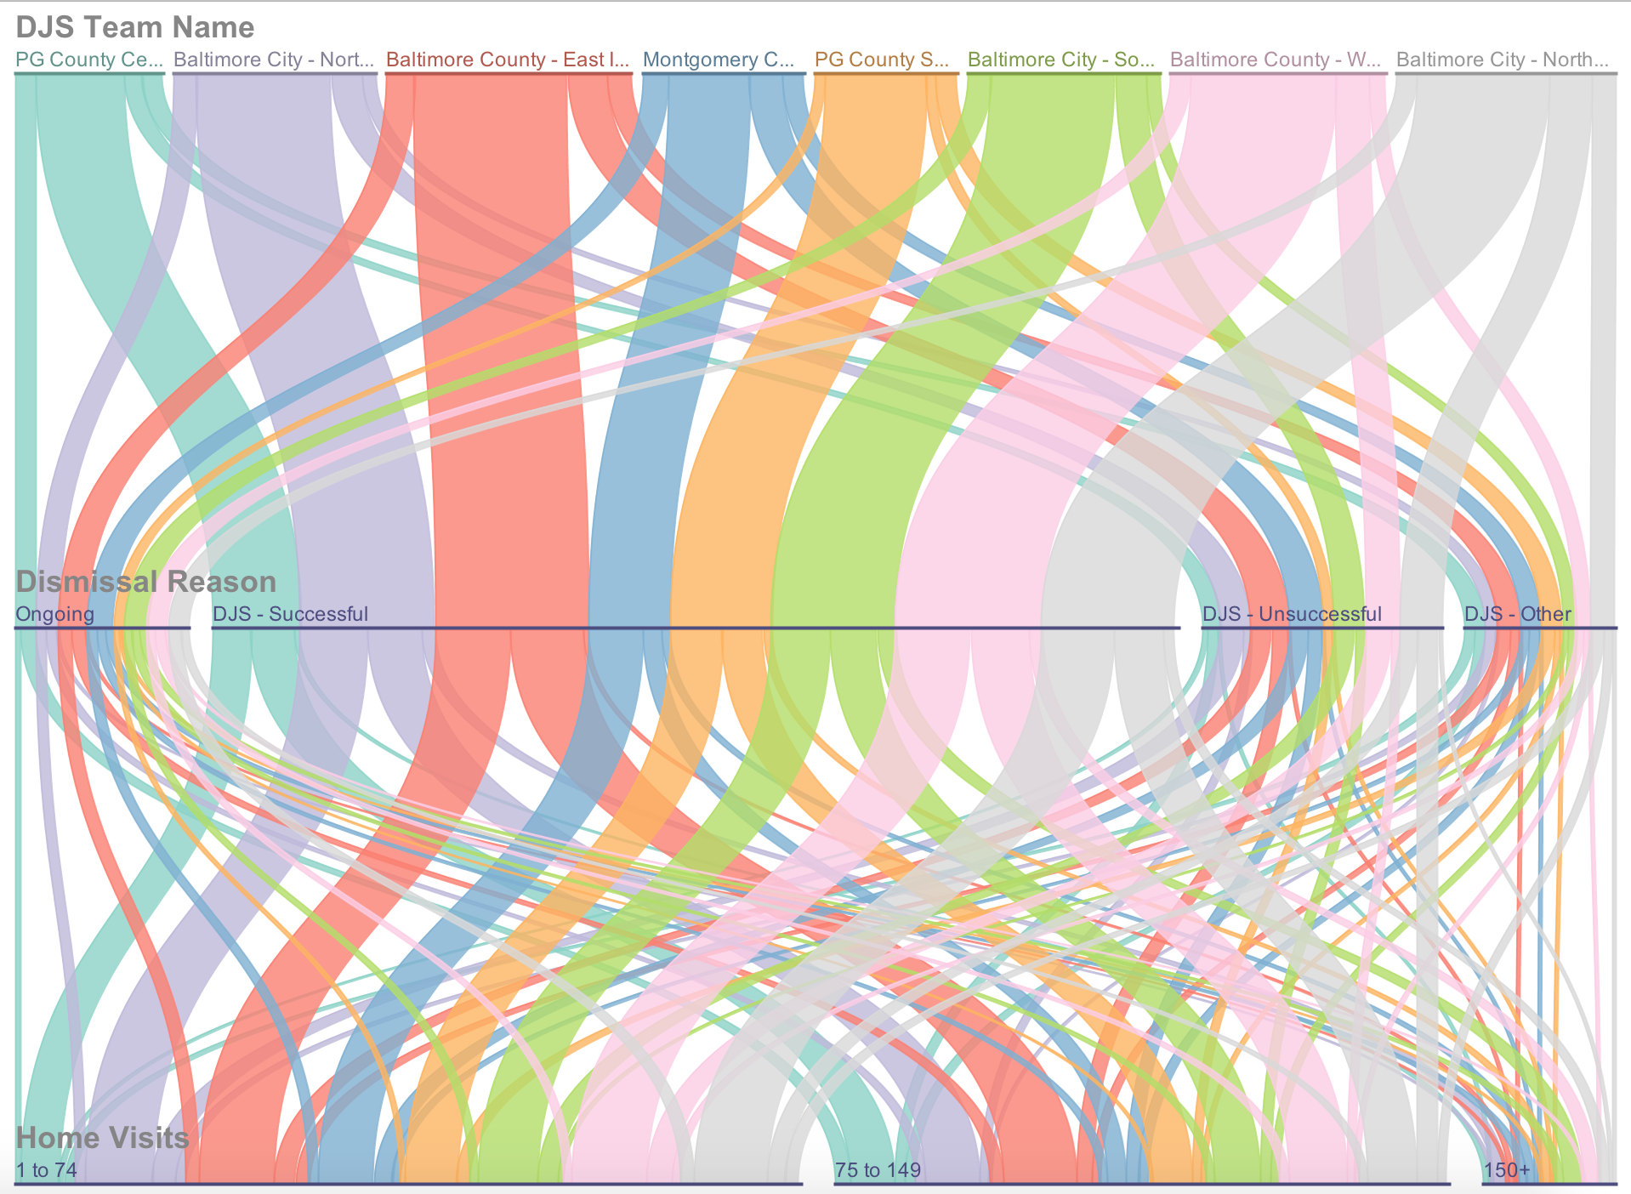
Results
Parallel Sets
Visualization Findings: A greater number of home visits does have a positive effect on successful outcomes, but it shouldn’t be the only measurement for team’s effectiveness.
Client Response: We hope that our client will use this tool to explore her data and gain further insight into which teams are most effective and why.

Slide 13
Conclusion and Future Work
In order to fully realize the goals of our client, we created three distinct visualizations that all offered interactions with different aspects of the data.
Additionally we could have added the ability to separate the phone call heat map by month or team and included the functionality to easily import new data sets so that our visualization could continue to be used for additional years of Choice data.

Slide 14
Questions?

